Slide 1


Supervised By:
Prof. Dr. Hala Abdel-El Galil

Slide 2
Agenda
Introduction
Problem Definition
Related Work
Data Acquisition & pre-processing
Training Data
Solution Methodology
Implementation
Experiments
Results
Conclusion & Future Works

Slide 3
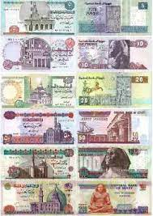

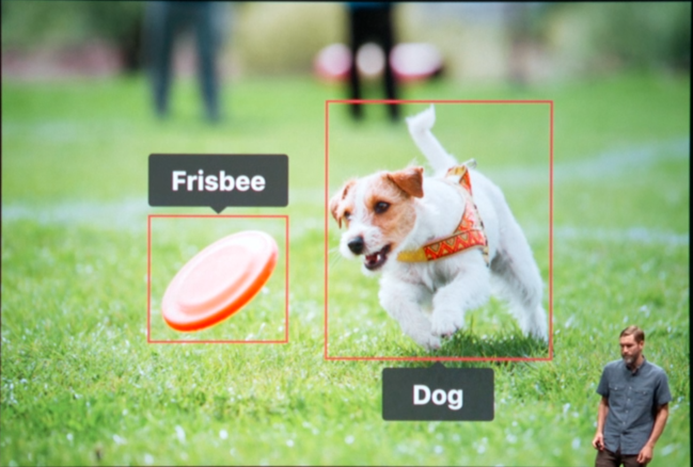
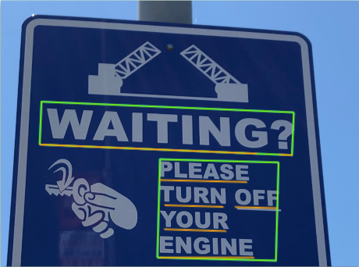
Introduction
Software of Smart Glasses
What are features in our Software ?
1. Egyptian Currency Detection 2. Object Detection 3. Text Detection 4. Voice Command

Slide 4
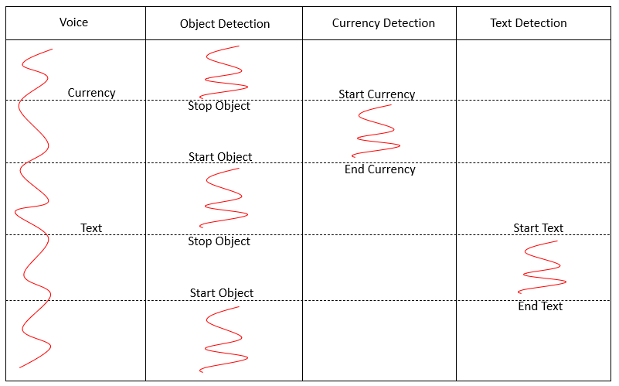
Introduction cont.
How Features work together ?
Using Threading.

Slide 5
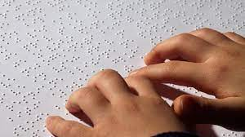
Problem Definition
3.5 Million Egyptian
It can help
- Students

Slide 6
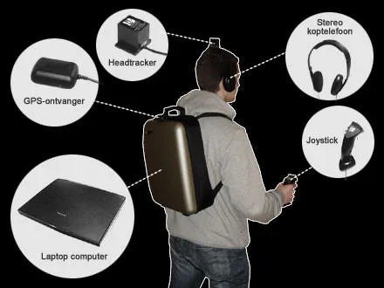
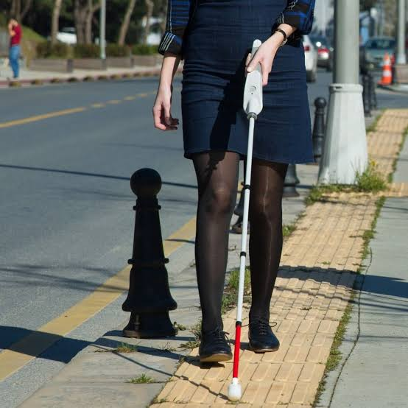
Related Work
Back-pack
We-Walk

Slide 7
Data Acquisition & pre-processing
Object dataset
storage.googleapi
Three objects(person,chairs,stairs)
cleaning
amount(4k) 80% train and 20% validation
data labeling(pascal .xml)
Currency Dataset
Kaggle.com
six objects
amount(10k) 80% and 20%
data labeling

Slide 8
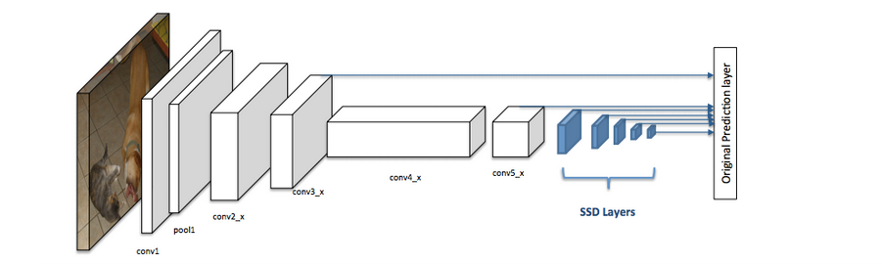
Solution Methodology
MobileNetV2 + SSDLite
Why this model?
SSDLite has two components:
backbone model
SSD head

Slide 9
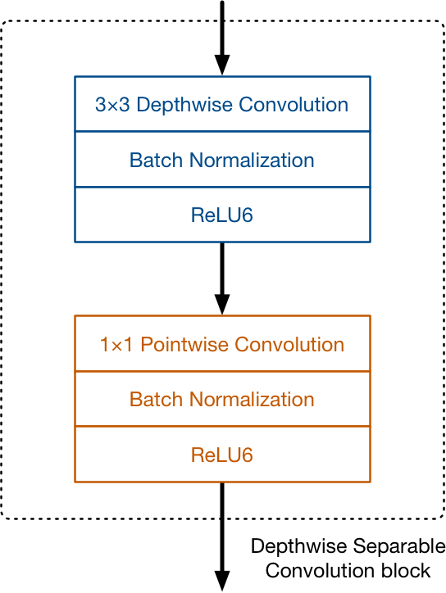
Implementation
Regular Convolutional Layer
quite expensive to compute
MobileNetV1 structure
DepthWise Separable
DepthWise Convolution
Filters the input
DepthPoint Convolution
Combines the filtered values to create new feature

Slide 10
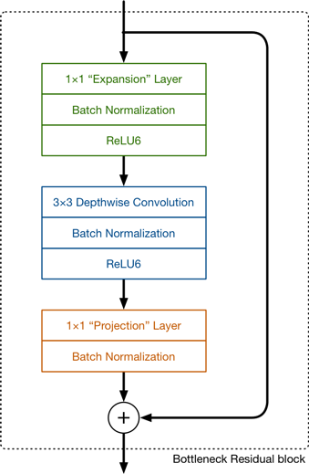
Implementation
MobileNetV2 structure
expansion layer
The default expansion factor is 6
depthwise convolution
projection layer
Bottleneck layer
Residual connection

Slide 11
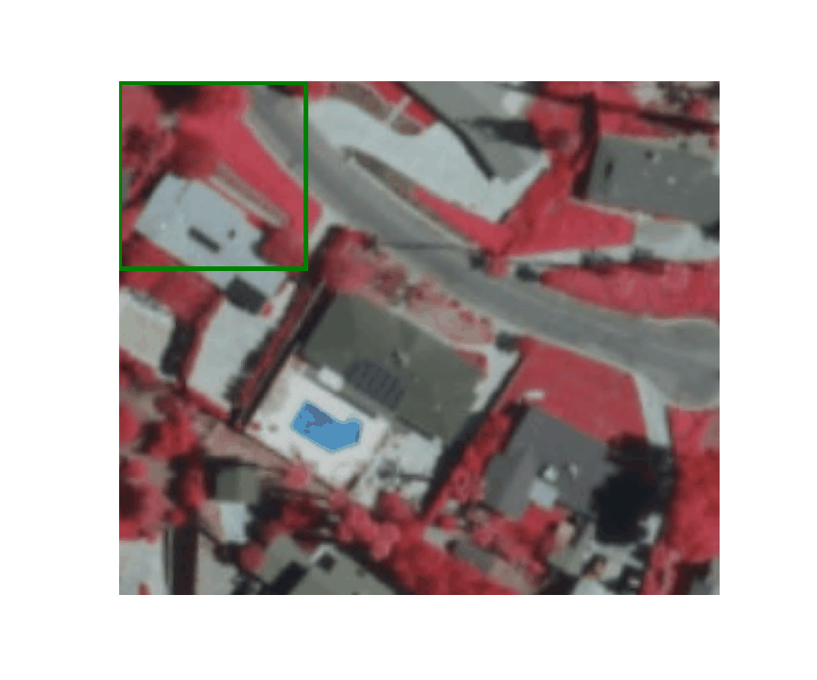
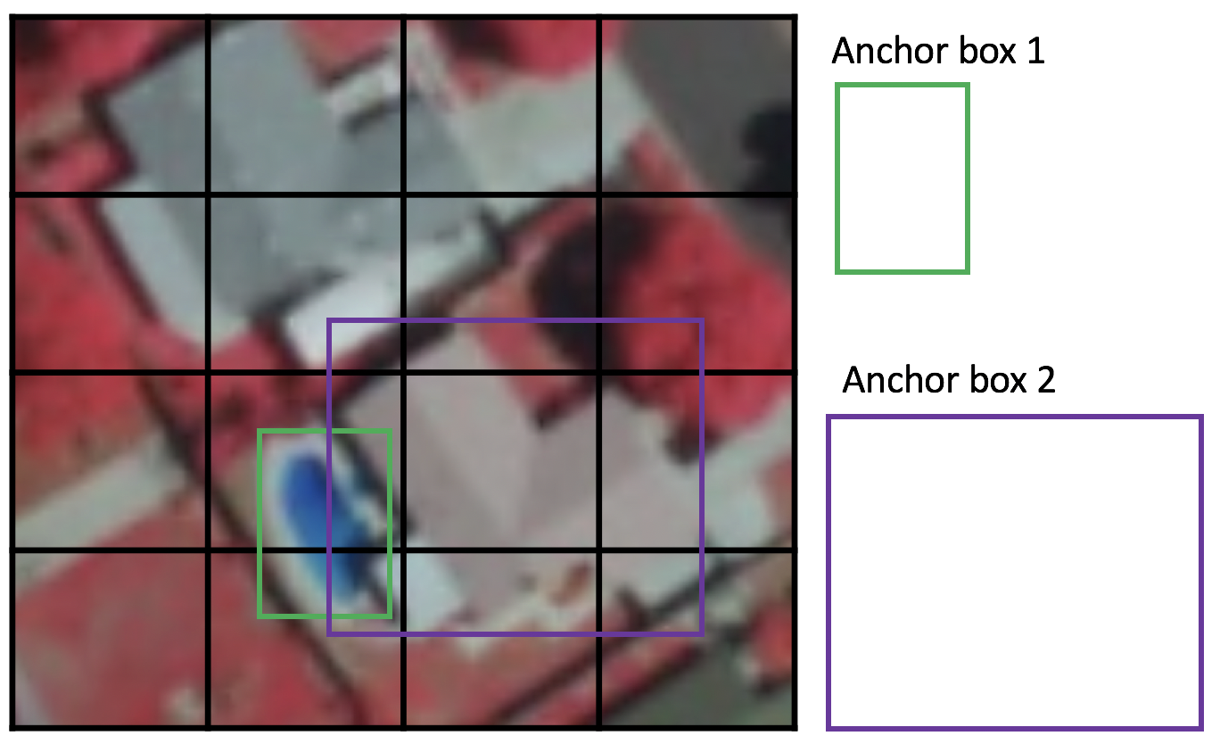
Implementation
Sliding Window approach
SSD for Detection
Grid cell
Anchor box
matching phase while training
each anchor box specified with aspect ratio and a zoom level.

Slide 12
Training Data
Google Colab Disadvantages
checkpoints
Easy to train model in stages
learning rate
Currency&opjects

Slide 13
TensorFlow=>Tensorboard
is open source machine learning software library .it uses in many sub-dimension and inference but has specific focus in training and inference of deep neural network.
we are going to develop an end-to-end solution using TensorFlow to train a custom object-detection model in Python, then put it into production, and run real-time inferences in the browser through TensorFlow.js.

Slide 14
TensorBoard:TensorFlow visualization toolkit
TensorBoard provides the visualization and tooling needed for machine learning experimentation:
Tracking and visualizing metrics such as loss and accuracy
Visualizing the model graph (ops and layers)
Viewing histograms of weights, biases, or other tensors as they change over time

Slide 15
Parameter & HyperParameter
Parameter: Parameters are the configuration model, which are internal to the model.
Parameters are essential for making predictions
estimated from data
1- Weight
2- Biases.
HyperParameter: Hyperparameters are the explicitly specified parameters that control the training process
Hyperparameters are essential for optimizing the model.
used in processes to help estimate model parameters.
Optimizer
Loss
Metrics
4-number of hidden Nodes and Layers,input features, Learning Rate, Activation Function etc in Neural Network.

Slide 16
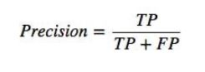
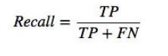
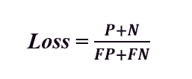
Experiments
T prediction is correct even if person or not
F prediction is incorrect.
P positive its person.
N negative it's not person.
TP Expect that he was a person and already he is a person .
TN Expect that he wasn’t a person and already he isn’t a person.
FP Expect that he wasn’t a person and already he is a person.
FN Expect that he was a person and already he isn’t a person.
What proportion of my detections
were correct?
What proportion of the actual objects did i capture ?
A method of evaluating how well the model is performing against the data provided

Slide 17
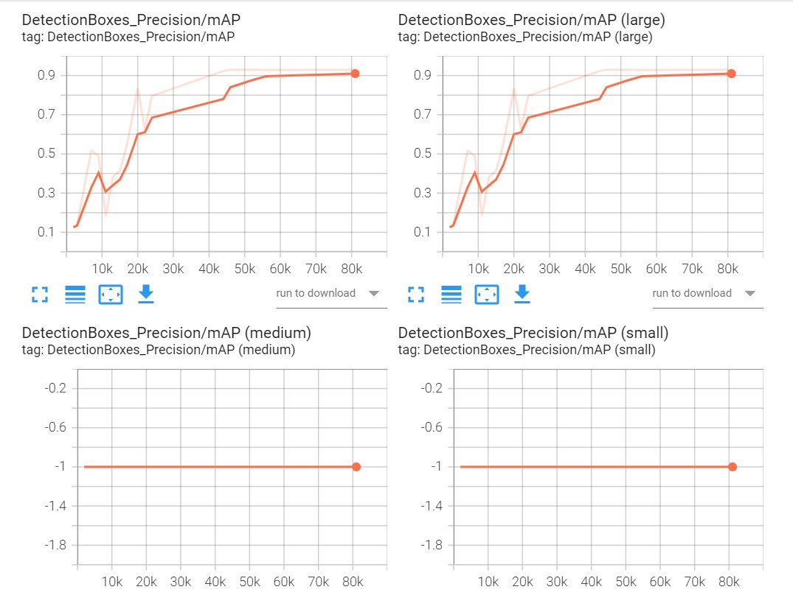
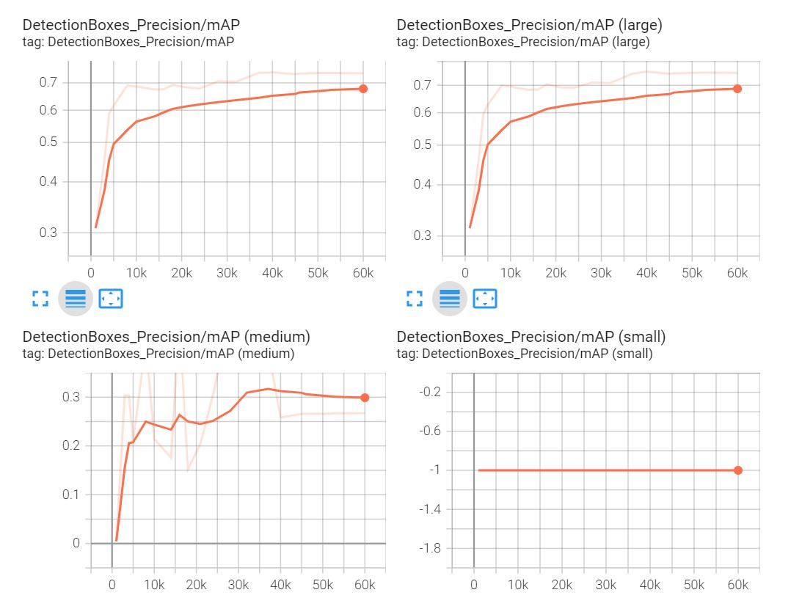
Experiments (Precision)
Currency
Object

Slide 18
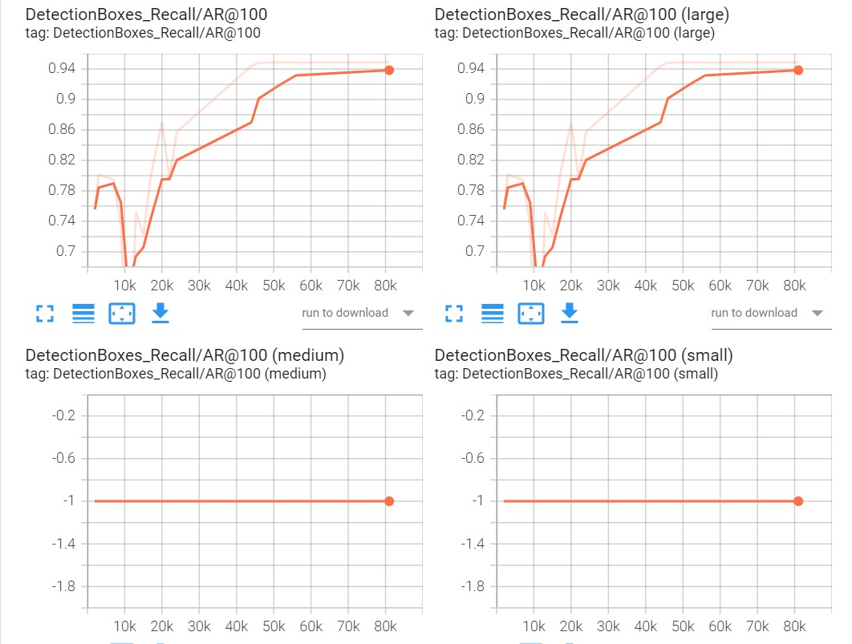
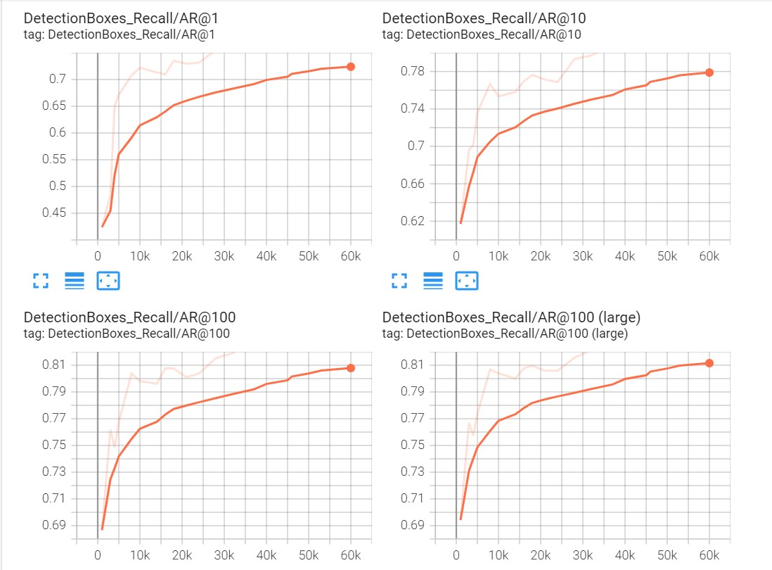
Experiments (Recall)
Currency
Object

Slide 19
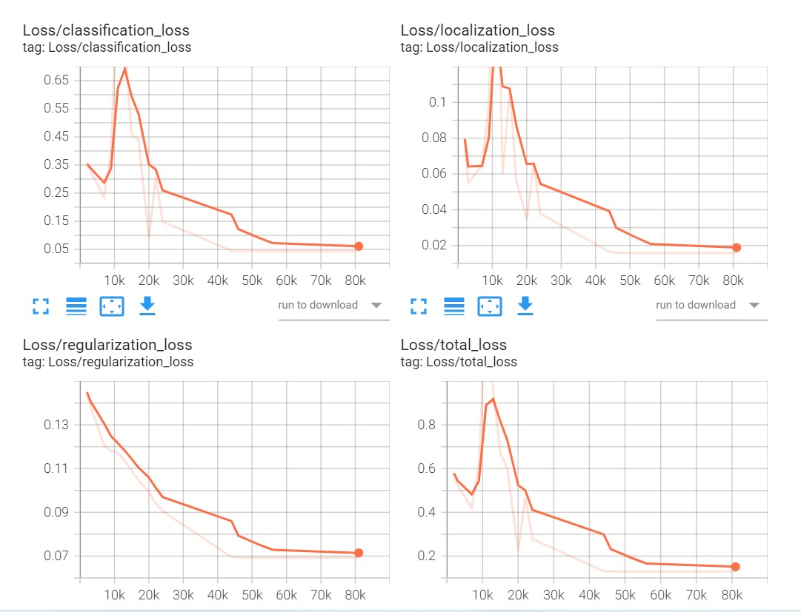
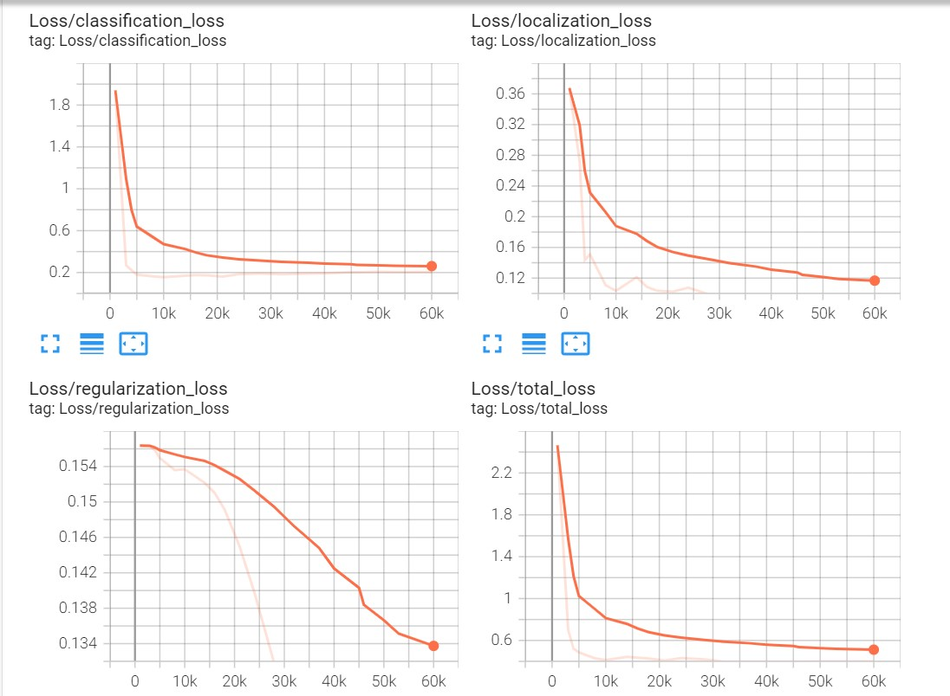
Experiments (Loss)
Currency
Object

Slide 20
Graphs
precision:
DetectionBoxes_Precision/mAP( mean average precision over classes averaged over IOU thresholds ranging from .5 to .95 with .05 increments.
(small, medium, large)
1-DetectionBoxes_Precision/mAP (small)': mean average precision for small objects (area < 32^2 pixels).
2-'DetectionBoxes_Precision/mAP (medium)': mean average precision for medium sized objects (32^2 pixels < area < 96^2 pixels).
3-'DetectionBoxes_Precision/mAP (large)': mean average precision for large objects (96^2 pixels < area < 10000^2 pixels).
Recall:
DetectionBoxes_Recall/AR@100 1( average recall with 100 detection)(small, medium, large):
1-DetectionBoxes_Recall/AR@100 (small)': average recall for small objects with 100.
2-'DetectionBoxes_Recall/AR@100 (medium)': average recall for medium objects with 100.
3-'DetectionBoxes_Recall/AR@100 (large)': average recall for large objects with 100 detections

Slide 21
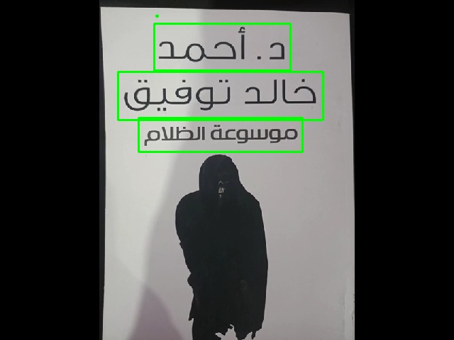
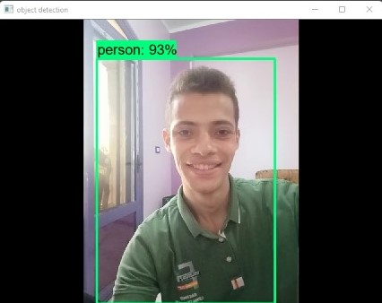
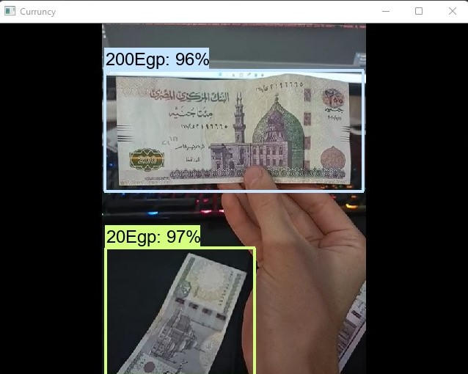
Results
Currency detection
Text detection
Object detection

Slide 22
Conclusion & Future Works
Compare Datasets (Object &Currency)
Features will be added
GPS & Maps
Hardware

